Slide 1
1-Prescrotal castration
B-Closed prescrotal castration.
“Closed” castration is performed similarly to the “open” technique just described, except that the parietal vaginal tunics are not incised. Maximally exteriorize the spermatic cord by reflecting fat and fascia from the parietal tunic with a gauze sponge. Place traction on the testicle while the fibrous attachments between the spermatic cord tunic and scrotum are torn. Place an encircling ligature (2-0 or 3-0 abso.) around the entire spermatic cord and tunics. Pass the needle of a second ligature through the cremaster muscle, or between structures within the tunic, for a transfixation ligature proximal or distal to the first.

Slide 2
2-Scrotal ablation
Elevate the scrotum and testicles from the body wall. Make an elliptical skin incision at the base of the scrotum, being careful not to excise too much skin. Control hemorrhage with electrocoagulation, ligation, or pressure. Incise the vaginal tunics, and remove the testicles as described for open castration. Remove the scrotum after incising its median septum. Appose subcutaneous tissues with a simple continuous suture pattern (e.g., 3-0 absorbable suture). Appose skin edges with approximating interrupted sutures (e.g., 3-0 or 4-0 nonabsorbable suture).

Slide 3
Feline castration
For an overhand or figure-eight knot, the spermatic cord is tied on itself with the aid of a curved mosquito hemostat. Preferably the parietal vaginal tunic is separated from the epididymis before tying the knot. Place the hemostat on top of the cord. Wrap the distal (testicle) end of the cord over the hemostat once. Direct the wrapped hemostat ventral to the cord while holding the testicle in the opposite hand. Open the tips of the hemostat, and grasp the distal end of the cord. Transect the spermatic cord near the testicle, and manipulate the severed end of the cord through the loops around the hemostat. Snug the knot, resect excess cord, inspect for bleeding, and replace the cord within the tunic before releasing.

Slide 4
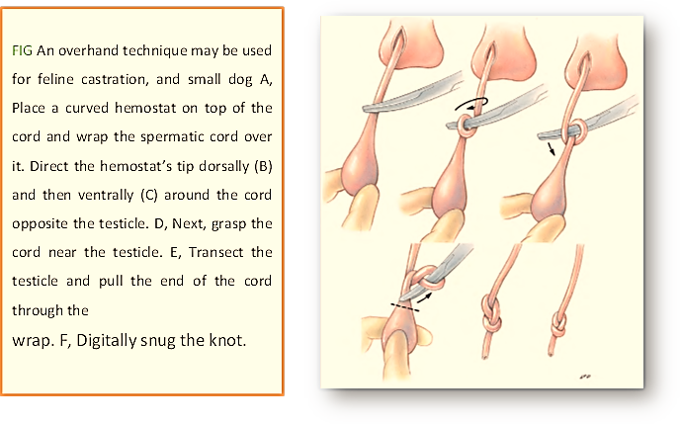

Slide 5
Vasectomy
Vasectomy.
A, The ductus deferens is located lateral to the prepuce and
penis between the inguinal rings and scrotum.
B, Incise skin over the spermatic cord between the inguinal ring and scrotum. Dashed line indicates vaginal tunic incision site.
C, Incise the vaginal tunic and isolate the ductus deferens. Ligate the ductus deferens and
remove a small segment.

